Slide 1
Investment Analysis & Management
DBMS Project
Sanat Mishra & Harshit Deskmukh
Notes:
To change the image on this slide, select the picture and delete it. Then click the Pictures icon in the placeholder to insert your own image.

Slide 2
Glossary
Portfolio: A Portfolio is a collection of stocks owned by an individual designed to achieve specific financial goals.
Stock Exchange : A stock exchange is a place where investors can buy and sell shares of publicly traded companies, like a big marketplace for stocks.
Stock Broker: A stock broker is like a middleman who helps you buy and sell stocks in the stock market.
Dividend : Dividend is the money a company pays to its shareholders as a reward for owning its stock.

Slide 3
Objectives
Which portfolio has the maximum returns.
Which stock in portfolio has given the most returns.
Most preferred Broker by users
Most repeated stocks among the users.
Which Stock has given the most dividend

Slide 4
Schema
BROKER USER STOCK
Broker_ID(PK) User_ID (PK) Stock_Symbol(PK)
Broker_Name Age Stock_Name
Broker_rating Occupation Stock_Price
Broker_commission Broker_ID(FK) Market_Cap

Slide 5
Schema
PURCHASE/SELL PORTFOLIO EXCHANGE
Broker_ID(FK) Portfolio_ID Exchange_ID
Stock_ID(FK) Portfolio_returns Exchange_Name
User_ID(FK) Stock_ID(FK)
DIVIDEND HOLDING
Dividend_yield Portfolio_ID(FK)
Dividend_Date Stock_ID(FK)
Dividend_type
Stock_ID(FK)

Slide 6
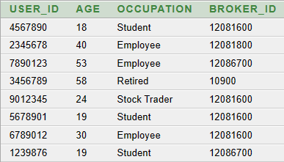
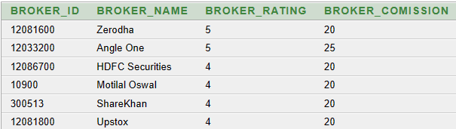
RELATIONAL TABLE
USERS CONTACTING BROKER (M:1)
USERS
BROKER

Slide 7
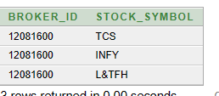
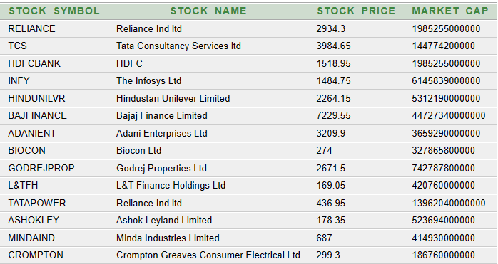
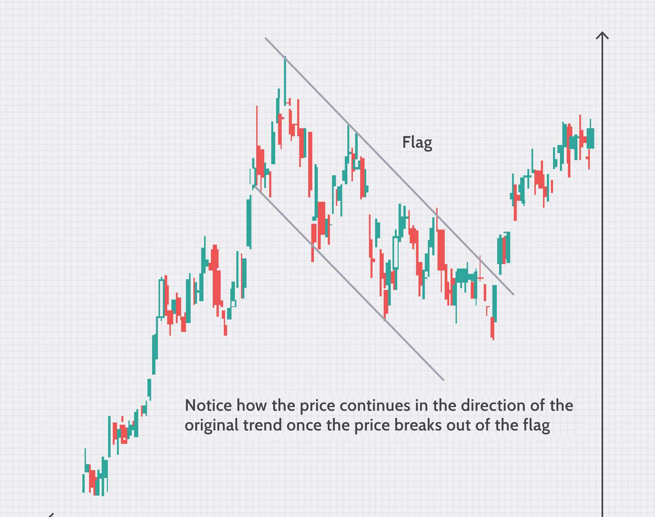
RELATIONAL TABLE
BROKER BUYS/SELLS STOCK(M:M)
PURCHASE
STOCK

Slide 8

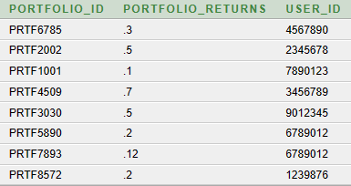
RELATIONAL TABLES
USERS HAVE PORTFOLIO(1:1)
PORTFOLIO

Slide 9
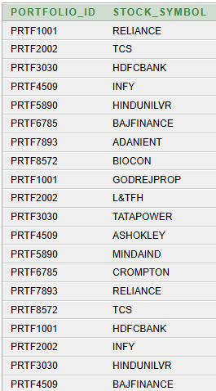

RELATIONAL TABLE
PORTFOLIO CONTAINS STOCKS (M:M)
HOLDINGS

Slide 10
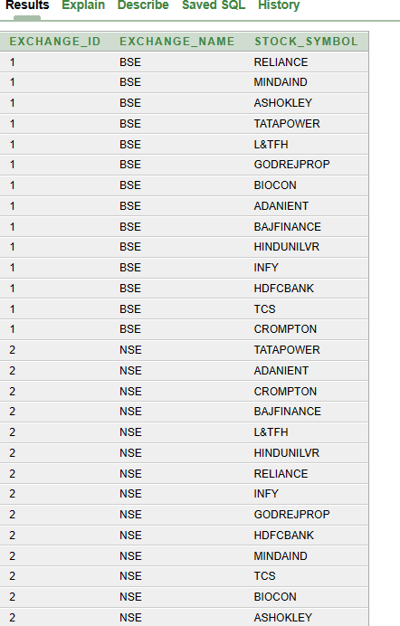
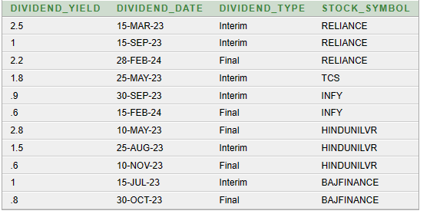
RELATIONAL TABLES
STOCKS LISTS IN STOCK EXCHANGE (1:M)
STOCK PAYOUT DIVIDEND (1:M)
STOCK_EXCHANGE
DIVIDEND

Slide 11


OBJECTIVES
Which portfolio has the maximum returns.
SELECT Users.user_id, Portfolio.Portfolio_returns
FROM Portfolio
INNER JOIN users ON Portfolio.user_id = users.user_id
WHERE Portfolio.Portfolio_returns= (
SELECT MAX(Portfolio_returns)
FROM Portfolio
)

Slide 12
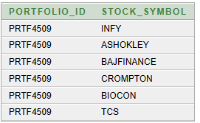


OBJECTIVES
Which stock in portfolio has given the most returns
select Portfolio_ID from portfolio
where user_id= 3456789
select * from holdings
where Portfolio_ID= 'PRTF4509'

Slide 13

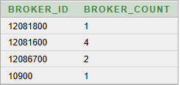
OBJECTIVES
Most preferred Broker by users
SELECT broker_id, COUNT(broker_id) AS broker_count
FROM users
GROUP BY broker_id

Slide 14


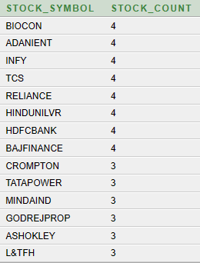

OBJECTIVES
Most repeated stocks among the users.
SELECT Stock_Symbol, COUNT(Stock_Symbol) AS Stock_COUNT
FROM holdings
GROUP BY Stock_Symbol
ORDER BY Stock_COUNT DESC

Slide 15


OBJECTIVES
Which Stock has given the most dividend
SELECT dividend_yield, stock_Symbol
FROM dividend
WHERE dividend_yield = (
SELECT MAX(dividend_yield)
FROM dividend
)

Slide 16
INTERPRETATION
THE USER ID 345678 HAS MAXIMUM RETURNS THAT IS 70%
The portfolio ID PRT4509 has maximum returns and the stocks in the portfolio are INFOSYS , ASHOKLEYLAND, BAJAJFINANCE, CROMPTON, BIOCON, TCS.\

Slide 17

INTERPRETATION
THE MOST PREFFERED BROCKER IS ZERODHA

Slide 18
INTERPRETATION
Most repeated stocks among the users are:-
TCS
ADANI ENTERPRISE
BIOCON
INFOSYS
RELIANCE
HINDUSTANUNILEVER
HDFC BANK
BAJAJFINANCE

Slide 19
INTERPRETATION
Most repeated stocks among the users.
HINDUSTANUNILEVER 2.8%

Slide 21
RELATIONAL TABLES
PORTFOLIO CONTAIN STOCKS(M:M)

